Slide 1

Welcome
To
Our Presentation
University Network Design

Slide 2
Group Member Name
Group Member Name | Student ID
Md.Thoufique Hasan Rakib | 18191203012
Md.Aminur Rhman | 18191203013
Prottay Kumar Biswas | 18191203018

Slide 3
Supervised By
Md. Saifur Rahman
    Assistant Professor and Chairman
    Department of Computer Science and Engineering
    Bangladesh University Of Business and Technology (BUBT)
    Mirpur -2,Dhaka-1216,Bangladesh

Slide 4
Thoufique Hasan Rakib
ID- 18191203012
Department- CSE
Intake- 31(Eve)

Slide 5
Table of Content
Introduction
Objectives
Scope
Hierarchical Internetworking Model
Access Layer
Core Layer
Distribution Layer
Network Component
Configuration
Methodology
Network Design

Slide 6
Introduction
Network design refers to the planning of the implementation of a computer network infrastructure.
Network design is generally performed by network designers, engineers, IT administrators and other related staff. It is done before the implementation of a network infrastructure
A network is two or more computers (or other electronic devices) that are connected together, usually by cables or Wi-Fi.
Some computer networks will have a server. A server is a powerful computer that often acts as a central hub for services in a network, eg emails, internet access and file storage. Each computer connected to a server is called a client.
A computer that is not connected to a network is called a standalone computer.

Slide 7
Objectives
To prevent the high cost for this network design.
Summarization reduces the amount of information stored in the routing table and makes the routing process more efficient.
Dynamic Host Configuration Protocol (DHCP) is useful for automatic configuration of client network interfaces.
Accessing internet services from organizations

Slide 8
Methodology
There are six steps in ensuring this project achieves its objectives. Firstly, the literature reviews the networking fundamentals, especially on routing and switching processes. Based on the study, it is known that the routing and switching process is completely complex. There are several things that need to be considered in the routing process, such as; the path determination, choosing the best algorithm to be used, using the suitable routing protocol, and etc.

Slide 9
Scope
The project is designed for infrastructure where it can be used on a small scale. This project is currently working on a small number of devices but may add more devices and connections in the future. The device consists of various computers, routers, servers, connections and switches built with proper efficiency. Devices and associated connections are limited due to funding concerns of medium or small universities.
Therefore, anyone can say that the scheme plays an undeniable role in cost containment in due course.

Slide 10
Prottay Kumar Biswas
ID- 18191203018
Department- CSE
Intake- 31(Eve)

Slide 11
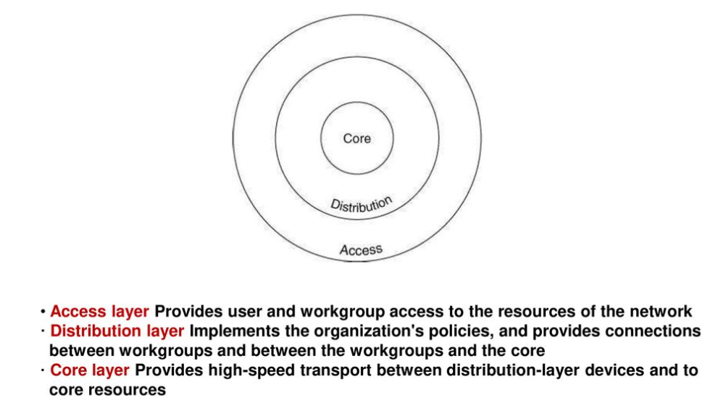
Hierarchical Internetworking Model

Slide 12
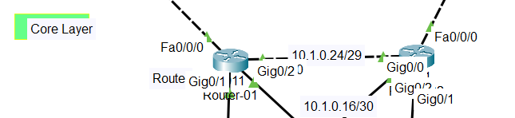
Core Layer
The core is the backbone of a network, where the internet(internetwork) gateway are located. The core network provides high-speed, highly redundant forwarding services to move packets between distribution-layer devices in different regions of the network.

Slide 13
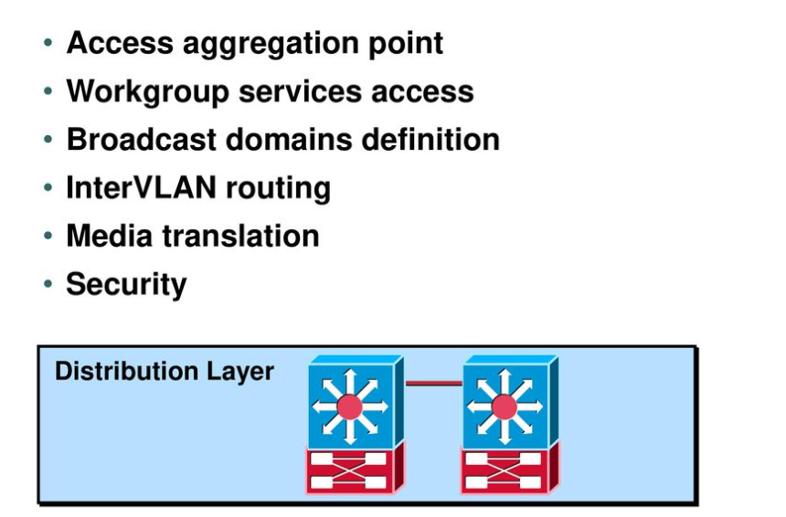
Distribution Layer

Slide 14
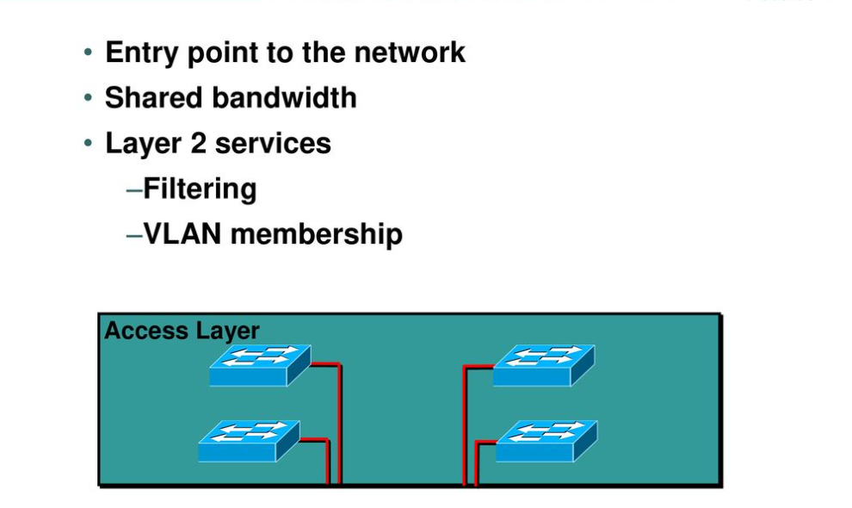
Access Layer

Slide 15
Network Component

Slide 16
Network Component
1. Packet Tracer
2. PC
3. Router
4. Cable
5. Switch
6. Server

Slide 17
Configuration

Slide 18
Configuration
Router
Layer 3 Switch
Layer 2 Switch
Server
OSPF
HSRP
OSPF
HSRP
DHCP
Vlan
SSH
HostName Change
Banner Change
VLAN
Telnet
SSH
HostName Change
Banner Change
FtpServer
Smtp Server

Slide 19
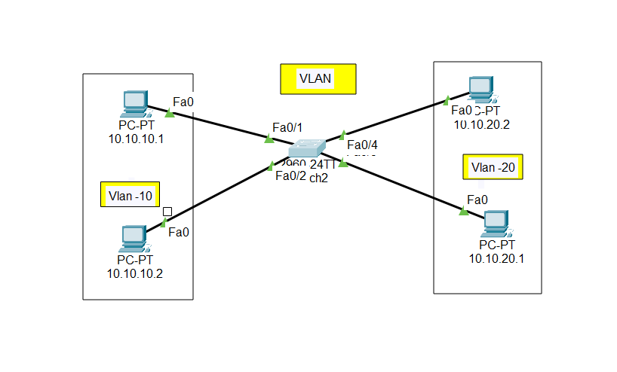
VLAN
A LAN is a grouping of two or more devices on a network. A VLAN is a virtual LAN, a subgroup within a local network.
VLANs make it easy for network administrators to separate a single switched network into multiple groups to match the functional and security requirements of their systems.

Slide 20
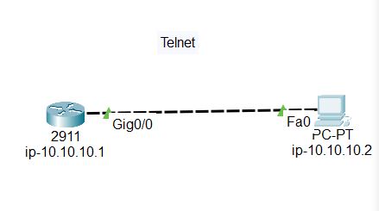
TELNET
Telnet is a user command and an underlying TCP/IP protocol for accessing remote computers. Through Telnet, an administrator or another user can access someone else's computer remotely.

Slide 21
Md. Aminur Rhman
ID- 18191203013
Department- CSE
Intake- 31(Eve)

Slide 22
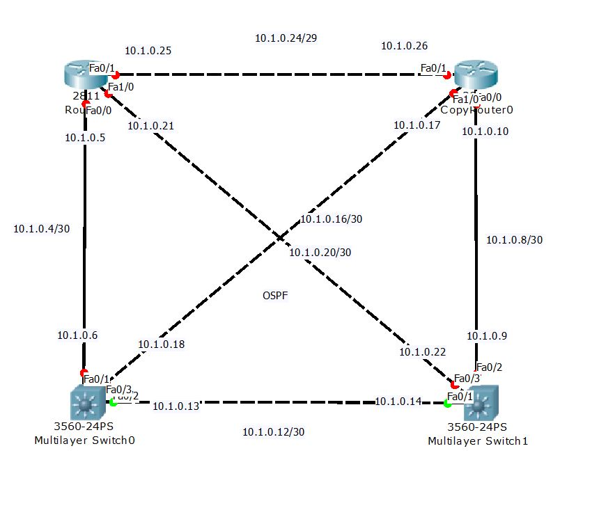
OSPF
OSPF is an interior gateway protocol (IGP) that routes packets within a single autonomous system (AS). OSPF uses link-state information to make routing decisions, making route calculations using the shortest-path-first (SPF) algorithm (also referred to as the Dijkstra algorithm).

Slide 23
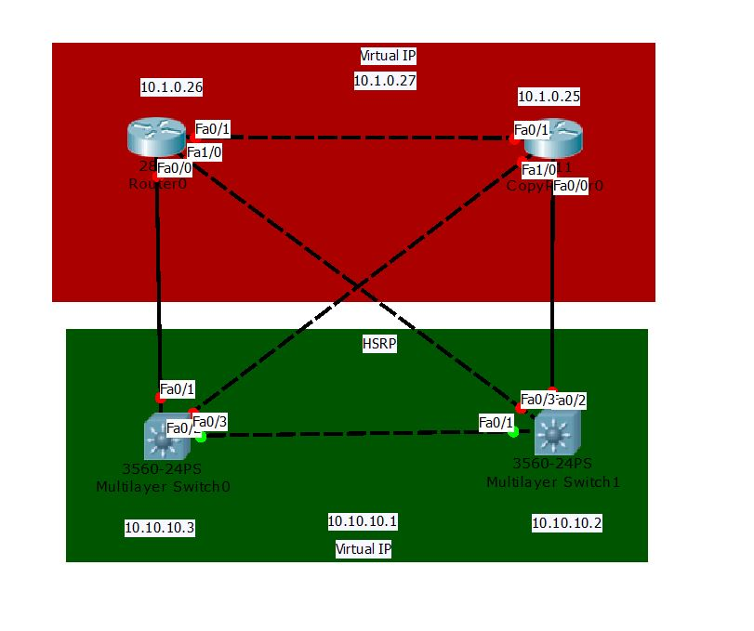
HSRP
HSRP is a Cisco proprietary redundancy protocol that allows failover of the next-hop IP device. It operates with an Active-Standby Model where only one device is supporting end-user traffic at any time, and the other device is on standby waiting to take over should the active device fails.

Slide 24
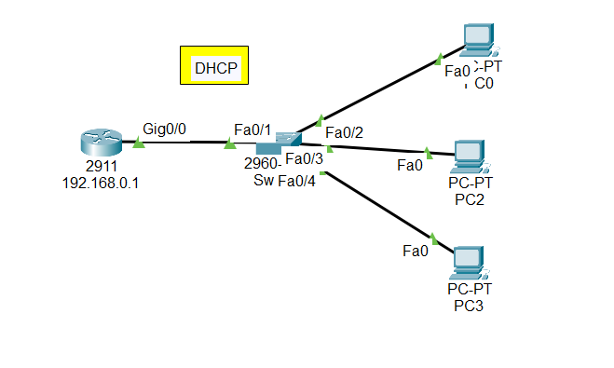
DHCP
Dynamic Host Configuration Protocol (DHCP) is a client/server protocol that automatically provides an Internet Protocol (IP) host with its IP address and other related configuration information such as the subnet mask and default gateway.

Slide 25
Network Design

Slide 26
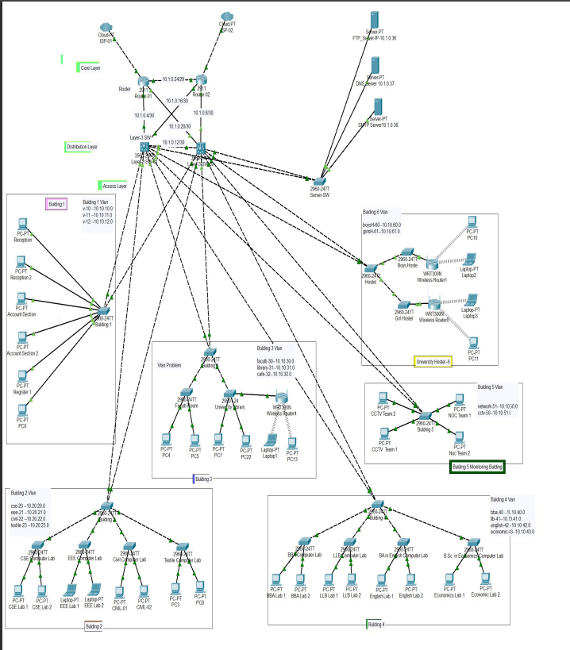
University Network Design

Slide 27
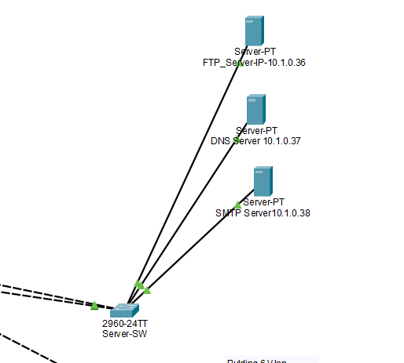
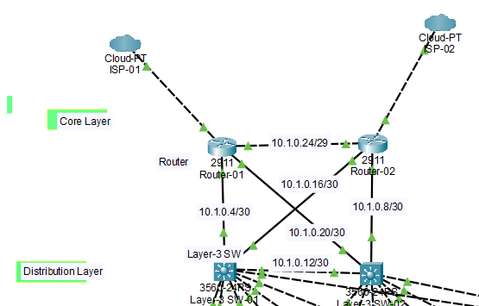
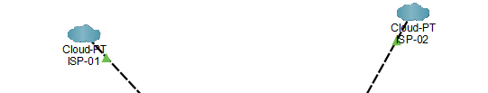
Network Design
Server
Core Layer
ISP Setup

Slide 28
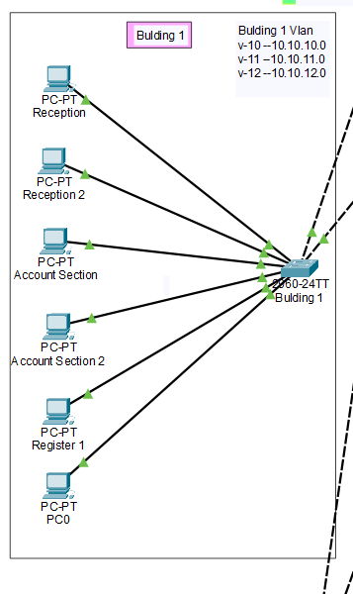
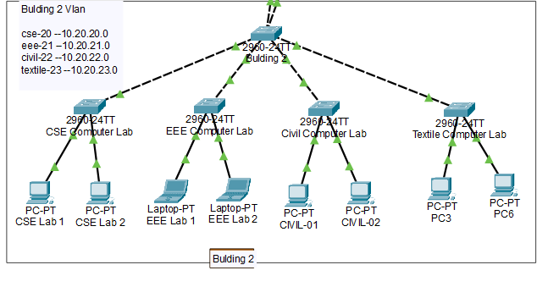
Network Design
Building 1
Building 2

Slide 29
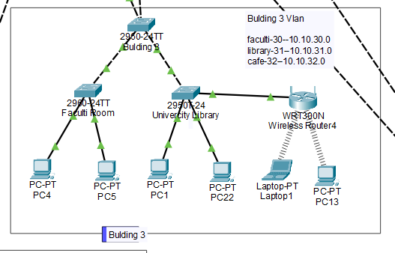
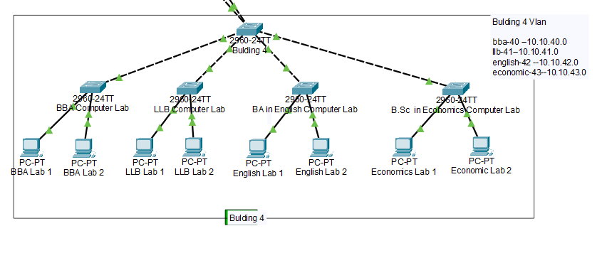
Network Design
Building 3
Building 4

Slide 30
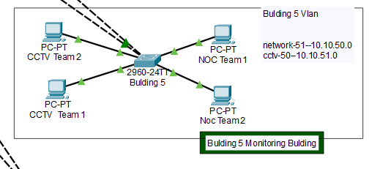
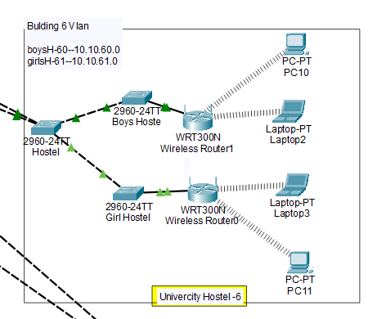
Network Design
Building 5
Building 6

Slide 31

Thank You

